Slide 1


Bootstrap: Week 2
Workshop Presentation

Slide 2

Today's Agenda
Activity | Estimated Duration
Check-In & Set-Up | 15 mins
Review | 60 mins
Workshop Assignment Task 1 | 45 mins
Break | 15 mins
Workshop Assignment Task 2 | 60 mins
Workshop Assignment Task 3 | 30 mins
Check-Out (Feedback & Wrap-Up) | 15 mins

Slide 3
Review: Color & Spacing Utility Classes
Discuss together:
What does ml-3 do?
What does p-5 do?
What does py-1 do?
What does mx-auto do?
Where would you find this information in the bootstrap documentation?
Please note: These types of questions are not meant to make you feel as if you need to memorize the answers, but to continue to get you accustomed to finding information from the documentation! If you can't answer this in-class by memory, by all means, look it up.

Slide 4
Review: Navbar
Discuss:
What does the .navbar-expand-sm class do?
What happens to a Navbar if you use the class .navbar-expand without specifying any breakpoint?
What happens to a Navbar if you leave out any navbar-expand class completely?
What does the data-target attribute in a navbar's navbar-toggler-classed button need to contain?
Answers in next slide

Slide 5
Answers: Navbar
Discuss:
What does the .navbar-expand-sm class do?
The .navbar-expand-sm class makes the navbar responsive on sizes small and up
On small screens it will be displayed vertically and left-aligned (because of the .navbar-expand-sm class)
What happens to a Navbar if you use the class .navbar-expand without specifying any breakpoint?
The .navebar-expand class will never collaps or display vertically.
What happens to a Navbar if you leave out any navbar-expand class completely?
If the .navbar-expand class is left out, the navbar will default to vertical alignment.
What does the data-target attribute in a navbar's navbar-toggler-classed button need to contain?
The toggler should point the div that you want to collapse, it should have the .navbar-collapse class.

Slide 6
Review: Breadcrumbs
Three types of breadcrumbs:
Location: most common, static.
Attribute: based on attributes of the page, less common.
Path (history trail): least common, messy, not recommended most of the time.

Slide 7
Review: Icon Fonts
Icon Fonts and SVG icons are the modern-day answer to icons.
Discuss: What are some advantages of using Icon Fonts over, for example, a PNG of an icon?
Answer in next slide.

Slide 8
Review: Icon Fonts
You can apply any CSS effects to them.
Because they are vector graphics, they’re scalable. That means you can scale them up or down without losing their quality.
You send one single or few HTTP request(s) to load them instead of multiple HTTP requests that bitmap images might require.
They load fast because of their small size.
They’re supported in all browsers (even back to IE6).

Slide 9

Review: Font-Awesome
KEY POINTS:
Font-Awesome is an extremely popular font and icon toolkit
Has a free version and a pro version.
Easy to use, quick grab and paste icon styles.
Use with <span> or <i> elements, both are OK:
<i class="fa fa-phone"></i> <span class="fa fa-phone"></span>

Slide 10
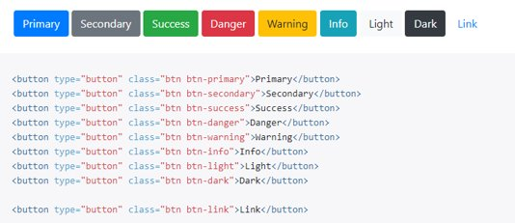
Review: Buttons
The Button component uses the .btn base class along with more classes for color and size.
Discuss:
What are the three HTML elements most often used for a Button component?

Slide 11

Review: Bootstrap-Social
Bootstrap-Social buttons are an icon font toolkit specifically used with Bootstrap's Button component along with Font-Awesome's social icons to create colorful, attractive, clickable social buttons.

Slide 12
Review: Forms
Forms have inputs and labels. Each label should have a “for” attribute that points to the id of the input it is for.
Bootstrap form classes:
“form-group” class which give margins for things grouped inside of forms. Textual form controls—like <input>s, <select>s, and <textarea>s—are styled with the “form-control” class. Add “col-form-label” class to your <label>s as well so they’re vertically centered with their associated form controls. Set heights using classes like .form-control-lg and .form-control-sm.

Slide 13
Review: Tables
Tables are built with the <table> HTML element.
Tables should not be used for page layout – we're not in 1995! :)
Build Bootstrap Tables by adding the "table" base class to the <table> start tag.
Optional styling classes include: table-striped, table-bordered, table-sm, table-dark, table-hover, more.
NOTE: The documentation for Bootstrap Tables is found in the Content section, not in the Components section.

Slide 14
Review: Cards
There is no <card> HTML element.
Cards are built using <div>s and other HTML elements.
Cards have no margin and no fixed width to start, and stretch to fill their parent element.
The optional card-body class will add a padded section.
Other useful, optional Card classes include:
card-title (can be used with a h* element such as h3)
card-header
card-footer

Slide 15
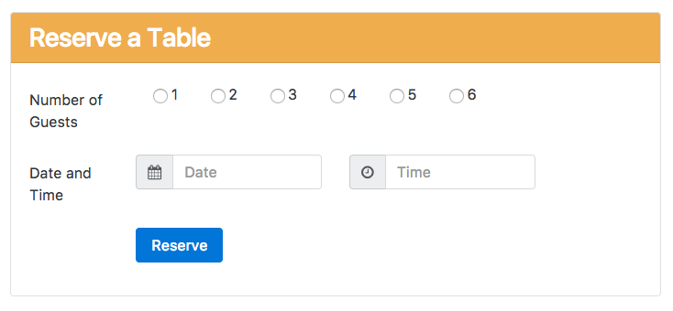
Review: Cards
Discuss:
What card classes is the card below using?

Slide 16
Review: Images
Check that everyone was able to download and extract the img zip file
Check that everyone has the img folder saved correctly (as /nucampsite/img/ and not as /nucampsite/img/img/ for example)
NOTE: Like Tables, the documentation on Images is in the Content section of Bootstrap's docs rather than the Components section
The .img-fluid Bootstrap class makes images responsive by applying these two styles:
max-width: 100%; height: auto;

Slide 17
Review: Media Object
The Bootstrap Media Object's documentation is in the Layout section, not the Components section.
The Media Object's purpose is to help easily lay out content next to a media file when you don't want the content wrapping around the media file.
Only two classes are required: the media class around everything (including the media, e.g. a photo) and the media-body class for the content (e.g., text about the photo) you want to align with the image.
To center a media object use the “align-self-center” class.
Discuss:
Can media objects be nested?

Slide 18
Review: Code Challenge
Review the Week 2 code challenge together.

Slide 19
Week 2 Workshop Assignment
All students should aim to finish and submit your assignment before you leave today.
Work in pairs, or groups of three. Talk to each other and figure things out together!
10-minute rule during workshops: If you and your paired partner have spent more than 10 minutes trying to figure something out, ask your instructor for help.

Slide 20
Happy learning!

